Slide 1

Nonemergency Medical Transportation (NEMT) Services (Overview)
Brian Ombongi| Benefit Policy Consultant
Monday, September 8, 2025
mn.gov/websiteurl

Slide 2
AGENDA
What is NEMT
Eligible Providers
Eligible Members
Covered Services
Noncovered Services
Excluded Costs Related to Transportation
Authorization Requirements
Documentation Requirements

Slide 3
Nonemergency Medical Transportation (NEMT) Services
NEMT provides Medical Assistance (MA) members with the safest, most appropriate and cost-effective mode of transportation to get to and from nonemergency medical service appointments

Slide 4
Nonemergency Medical Transportation (NEMT) Services
Local county or tribal agency-administered NEMT includes:
  Private automobiles (Mode 1 – personal mileage)
  Volunteer drivers (Mode 2 – volunteer driver mileage)
  Bus, taxicab or dial-a-ride, light rail or other commercial carriers (Mode 3 – unassisted and Mode 4 – assisted)
State-administered NEMT services:
  Ramp or lift equipped (wheelchair, scooter) (Mode 5)
  Protected (Mode 6)
  Stretcher transports (Mode 7)

Slide 5
Upcoming legislative update
Uniform Nonemergency Medical transportation program
  Local county or tribal agency-administered NEMT (Modes 1-4) will revert back to the state
  Effective day following final enactment. Section 43 para. (b) is effective:
    July 1, 2026, for medical assistance fee-for-service and
    January 1, 2027, for prepaid medical assistance.

Slide 6
Nonemergency Medical Transportation (NEMT) Services
For Mode 4 – assisted transportation, the member needs to call the MHCP medical review agent (Acentra) at 844-681-8144. Acentra will complete the transport level certification.
The MHCP medical review agent for (Modes 5 and 7) or mental health crisis team and some medical providers in specific situations (Mode 6) completes the transport level certification

Slide 7
Nonemergency Medical Transportation (NEMT) Services
Emergency Medical Transportation
Ambulance transportation services is the transport of a member whose medical condition or diagnosis requires medically necessary services before and during transport.
This includes air and ground, emergency and nonemergency ambulance services.

Slide 8
Eligible Providers
Eligible providers must meet the following:
MnDOT vehicle and driver requirements as established in Minnesota Statutes, 174.29 and 174.30.and Minnesota Rules, Chapter 8840. Excludes not-for-hire (personal mileage), volunteer driver and publicly operated transit systems.
Additional driver and attendant training for protected transportation services
MHCP provider enrollment or local county or tribal agency criteria

Slide 9
Eligible Members
The member must meet one of the following criteria to be eligible to receive NEMT services:
Enrolled in Medical Assistance (MA) – refer to Health Care Programs and Services under Provider Basics in the MHCP Provider Manual for more information)
Enrolled in state-only funded MA benefits due to residing in an institution for mental diseases (IMD)
Enrolled in Emergency Medical Assistance (EMA) – refer to Health Care Programs and Services under Provider Basics in the MHCP Provider Manual for more information

Slide 10
Eligible Members (cont)
A MinnesotaCare enrollee under the age of 19 - refer to Health Care Programs and Services under Provider Basics in the MHCP Provider Manual for more information
A pregnant person enrolled in MinnesotaCare
Enrolled in Refugee Medical Assistance (RMA)
Enrolled in Minnesota Family Planning Program (MFPP) – refer to Health Care Programs and Services under Provider Basics in the MHCP Provider Manual for more information

Slide 11
Covered Services
Local agency NEMT is a covered service when services are provided for the following:
To enable a member to obtain a covered health service. Transport is limited to a provider within 30 miles of the member’s home or residence for primary care and 60 miles from the home or residence for specialty care.
To enable eligible MHCP members to attend MHCP-related appeal hearings.
To provide a ride to MHCP-covered services from origination (pick-up) location to destination (drop-off) location by the most direct route. The member must use the most appropriate and cost-effective level of transport.

Slide 12
Covered Services
To allow the member, and when necessary, one responsible person who is needed to make medical decisions, learn about the member’s medical care, or in order to receive the medically necessary covered service. This includes, but is not limited to, a legal guardian, family member, relative or authorized representative
To transport one responsible person or one or more siblings from a single location separately from the member to enable family therapy services established in the member’s plan of care. This includes when a child or parent is in a residential facility and a responsible person, sibling(s) or spouse is required to attend to complete therapy service. The member receiving care does not need to be included in the transport.
When an additional attendant is needed to enable the transport of a member

Slide 13
Noncovered Services
Transportation of a member to a noncovered MHCP service and those services excluded from transportation payment
Transportation of a member from his or her residence to or from a day training and habilitation (DT&H) location or adult day program. Refer to the Day Training and Habilitation (DT&H) Day Services section of the MHCP Provider Manual for more information
Extra attendant charges for personal care assistants (PCAs) accompanying members for whom they are providing services
Use of a higher level of transport that is not medically necessary to meet the needs of the member
Transportation to waiver program services (review HCBS Waiver Services and Elderly Waiver [EW] and Alternate Care [AC] Program sections in the MHCP Provider Manual)

Slide 14
Noncovered Services
Transportation to the emergency room, unless it is for a scheduled appointment. or the emergency room is the entrance of an urgent care clinic
Transportation to an additional stop to pick up a parent, guardian, PCA or additional passenger to accompany the member.
Transportation to a destination that is different from the originally scheduled drop off. The drop-off destination cannot be changed after the trip is scheduled unless the transportation coordinator approves the change. The “transportation coordinator” could be the county, tribe or any entity hired to coordinate NEMT on their behalf
Transportation and ancillary services for hospital visits that are not necessary for making medical decisions
Transport of an emergency medical assistance (EMA) member to receive routine or preventative care (care that is not related to an approved EMA medical condition)

Slide 15
Excluded Costs Related to Transportation
Transportation of a member to a hospital or other site of health services for detention ordered by a court or law enforcement agency except when ambulance service is medically necessary
Transportation of a member to a facility for alcohol detoxification that is not medically necessary
No-load transportation, including no shows (refer to Covered Services under the Ambulance Transportation Services in the MHCP Provider Manual for no-load exception)
Wait time is considered part of overall service. Members should not incur additional charges for wait time.
Additional charges for luggage, stair carry of the member, and other airport, bus or railroad terminal services
Airport surcharge
Federal or state excise or sales taxes on air ambulance service

Slide 16
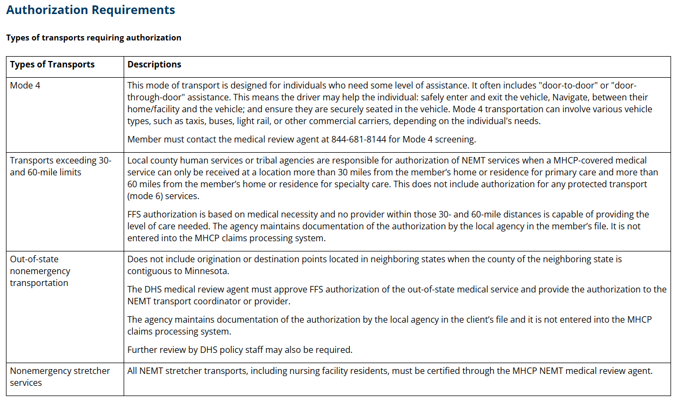

Slide 17
Documentation Requirements
1. The member’s name and MHCP ID number.
2. The date, or dates, the service is provided if different than the date the entry was made.
3. Either the printed name of the driver sufficient to distinguish the driver of service and also the driver’s UMPI number.
4. The date and signature of the driver attesting the record accurately represents the services provided and actual miles driven; and acknowledging that misreporting information that results in ineligible or excessive payments may result in civil or criminal action.
5. The date and signature of the member or authorized attesting that transportation services were provided as indicated on the transportation trip record, or the signature of the medical services provider certifying the member was transported to the medical services provider destination. If both the medical services provider and member, or authorized party, refuse or unable to provide signatures, the driver must document on the transportation trip record that signatures were requested and not provided.
6. The address, or the description if the address is not available, of both the origin and destination, and the mileage for the most direct route from origin to destination.
7. The name or number of the mode of transportation in which the service is provided.

Slide 18
Documentation Requirements
8. The license plate number of the vehicle used to transport the member.
9. The time of the member pickup.
10. The time of the member drop-off.
11. The odometer reading of the vehicle used to transport the member taken at the time of pickup.
12. The odometer reading of the vehicle used to transport the member at the time of drop-off.
13. The name of the extra attendant when an extra attendant is used to provide special transportation service.
14. Documentation indicating the method that was used to determine the most direct route.

Slide 19
Thank You!
Brian Ombongi
Brian.ombongi@state.mn.us
651-431-4828

