Slide 1

Recovering from Secondary Trauma in the Workplace
Frank Weber, M.S./L.P.
CORE Professional Services, PA

Slide 2


Secondary trauma is often used interchangeably with Vicarious trauma
Secondary trauma happens Vicarious trauma develops suddenly. over time

Slide 3




Who is vulnerable to secondary trauma? Those who
Listen to traumatic stories
Review case files or evidence
Respond to traumatic events
Provide care to trauma survivors

Slide 4


Workplace Factors that Amplify Risk
High caseloads
Lack of support & supervision
Organizational stress
Absence of self-care initiatives

Slide 5


Individual Risk Factors: High empathy Personal history of trauma Lack of coping strategies Inadequate training or experience

Slide 6


Burnout is the result of heavy workload. Exhausted, but feel needed. Feel ineffective and depleted.
Secondary trauma is result of exposure to traumatic material. Feel unsafe and your view of the world shifts to paranoia.

Slide 7

Impact of unrelenting cortisol production: frightened to erratic
Sympathetic nervous system = accelerator. Parasympathetic = brakes

Slide 8

Zagi
Kozarov v. Victoria
Employer was negligent for failing to take proactive and reasonable measures to prevent harm, despite being aware of the risks.

Slide 9

Kozarov v. Victoria
Zagi Kozarov was an attorney who prosecuted sexual abuse cases. Court ruled it’s the employer's duty of care to protect employees from psychological harm in the workplace. It was determined her employer was negligent for failing to take proactive and reasonable measures to prevent that harm, despite being aware of the risks.
Awarded $435,000
Zagi
Kozarov
Zagi
Kozarov v. Victoria
Employer was negligent for failing to take proactive and reasonable measures to prevent harm, despite being aware of the risks.

Slide 10
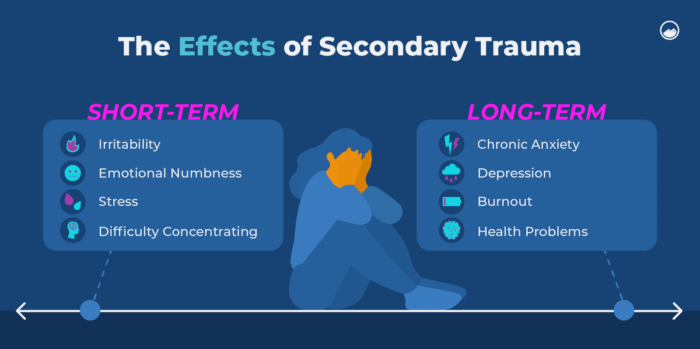
1. Recognize the signs

Slide 11

Emotional symptoms:
Irritability, guilt, fear, and sadness
Don’t give them the provoked response. Put it back on them.
What are you so angry about?

Slide 12

Physical symptoms: Fatigue, sleep disturbance, physical ailments, and changes in appetite.
Battle with: Exercise, diet, & sleep routine

Slide 13


Cognitive symptoms:
Intrusive thoughts, difficulty concentrating, avoidance & change in world view

Slide 14



2. Teach managers to respond compassionately
Everyone’s a client.

Slide 15

3. Model & support healthy behavior
When’s the last time you’ve said,
“Great job!”
Foster work/life harmony

Slide 16
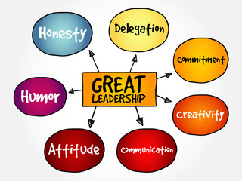

4. Supportive leadership & supervision
Offer guidance on difficult cases

Slide 17

5. Prevent & address harmful behavior
We don’t tolerate abuse from anybody.
Review how to exit danger.

Slide 18

6. Encourage mental health support
Ensure employees access to services is confidential

Slide 19


7. Manage work demands
Allow staff to offer suggestions
Deming method:
Bottom-up guidance

Slide 20



ABC’s of Managing Secondary Trauma
Awareness
Balance
Connection

Slide 21

Awareness
Identify the signs
Acknowledge the impact

Slide 22

Balance
Exercise
Healthy work-life balance
Mindfulness & relaxation
techniques
Creative expression
Social support

Slide 23



There are 3 ways to reduce the symptoms of depression:
Exercise = reduces symptoms of most forms of mental illness (excluding anorexia)
Therapy
Medication

Slide 24


Connection: Ask, listen & share
A sense of belonging is what people desire most, but few create it. You need to…

Slide 25
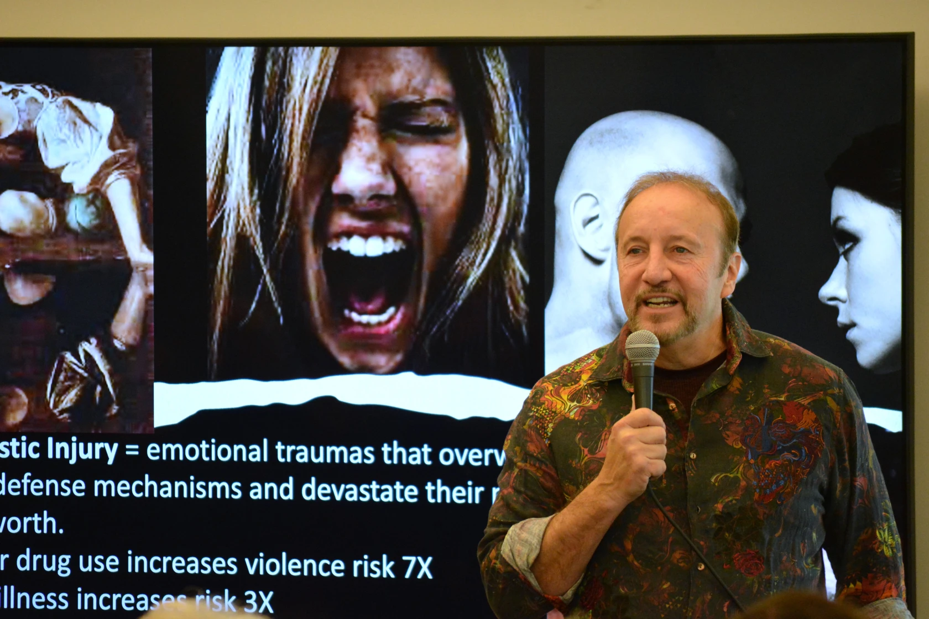
Website: Frankweberauthor.com
Frank Weber, M.S./L.P.
Clinical Director of
CORE Professional Services PA
Email: Frankw@coretreatment.com
Phone
(320) 202-1400

